Slide 1
URMC Caregiver Team
Chenwei Wu, Xuening Zhang, Haosong Rao, Meizhu Wang

Slide 2
Objectives
Data preprocessing:
○Clean and classify cancer treatments for use as an independent variable
Deliverable: an algorithm to apply to dataset
Data analysis:
○Develop predictive models for caregiver outcomes such as QoL. Compare these models to the logistic regression models in Kehoe et al paper

Slide 3
Achievements
Discussed objectives with URMC Team and walked through the data dictionary together.
Finished most of part 1, which is to develop a labeling algorithm to classify cancer treatments with generics and classes.
Created data visualizations and exploratory analysis.

Slide 4
Cancer Treatment Labeling
-Data given: Existing groups of labeled cancer treatments
-Goal: Label raw data of cancer treatments with correct class and generics

Slide 5
Out of the 541 rows of raw data in cth.csv, there are 173 empty rows and 368 non-empty ones.
Among the 368 rows with data, after fuzzy text matching by Levenshtein Distance, 132 rows can be assigned generics and classes with 100% certainty, remaining 236 rows.
For the remaining 236 rows, we generated rules of association in the labelled dataset using apriori-like approach and were able to label most of them except 42 treatments that doesn’t have existing relevant information.

Slide 6
Visualizations

Slide 7
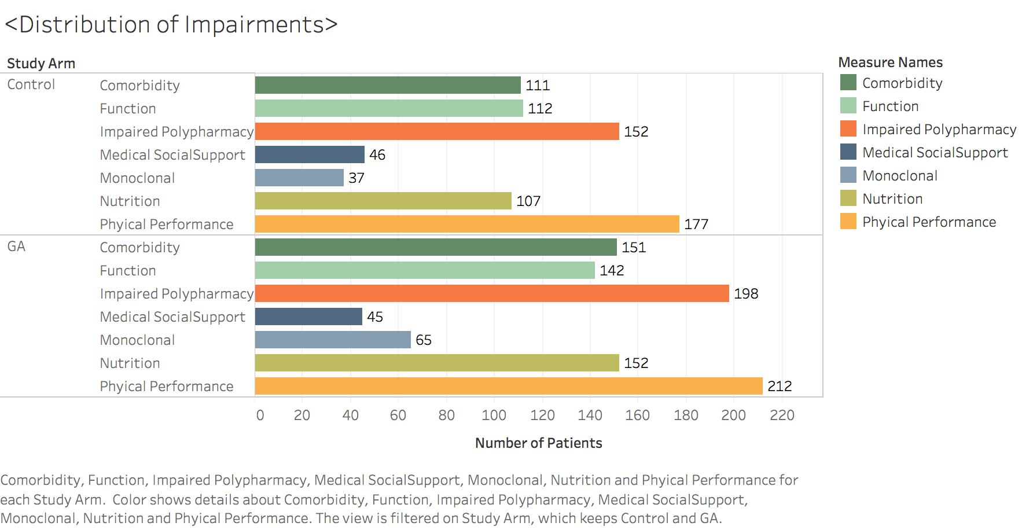
1.

Slide 8
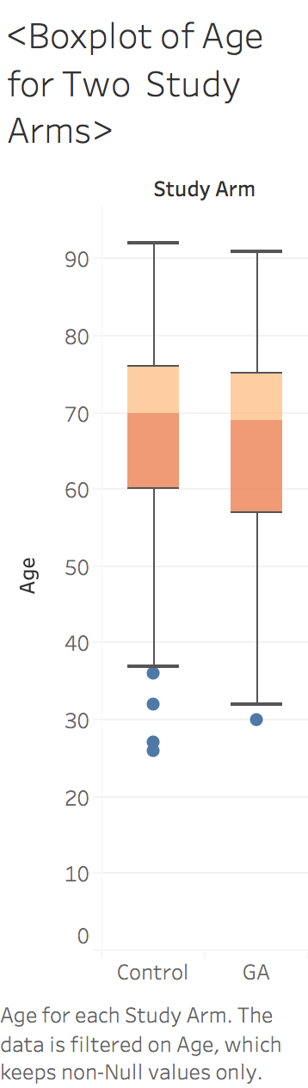
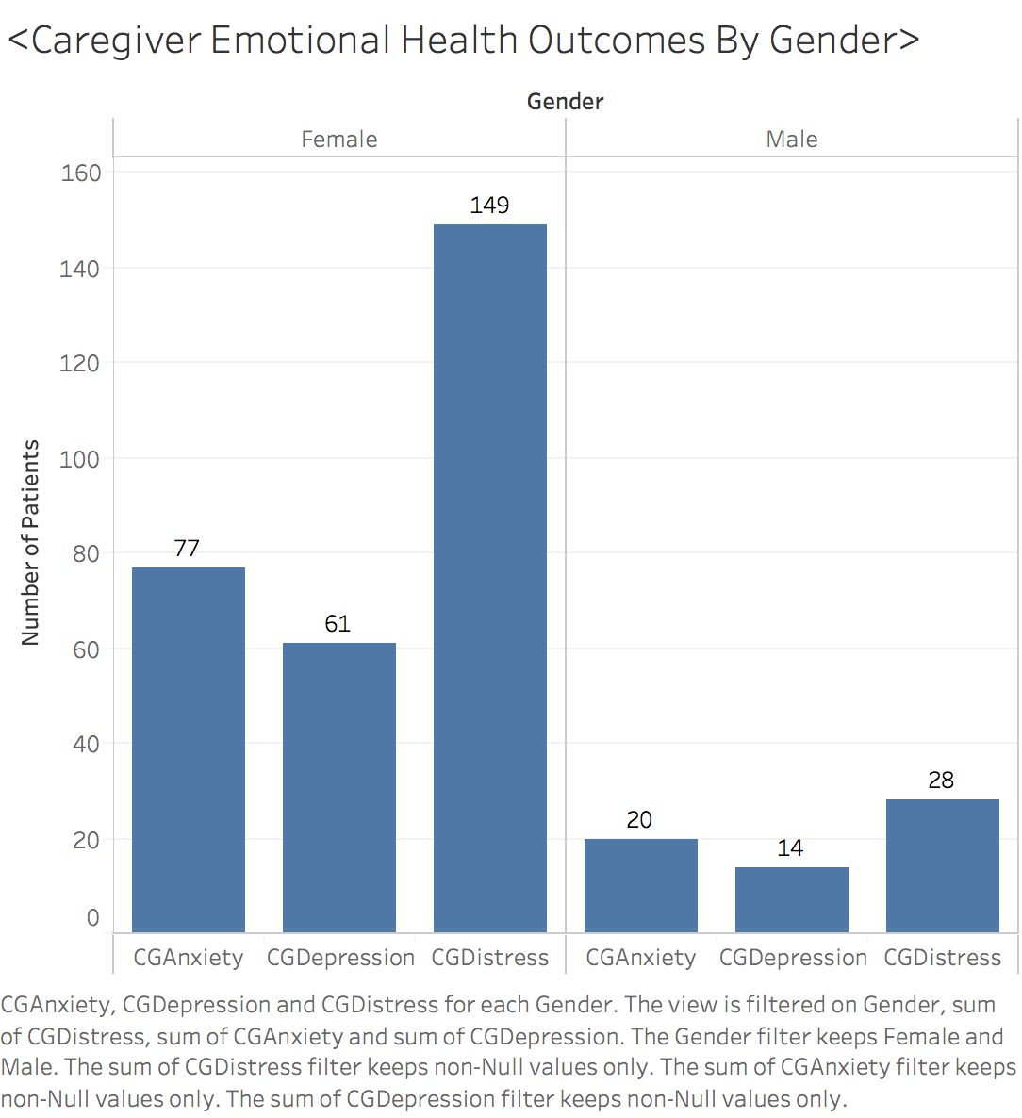
2.
3.

Slide 9
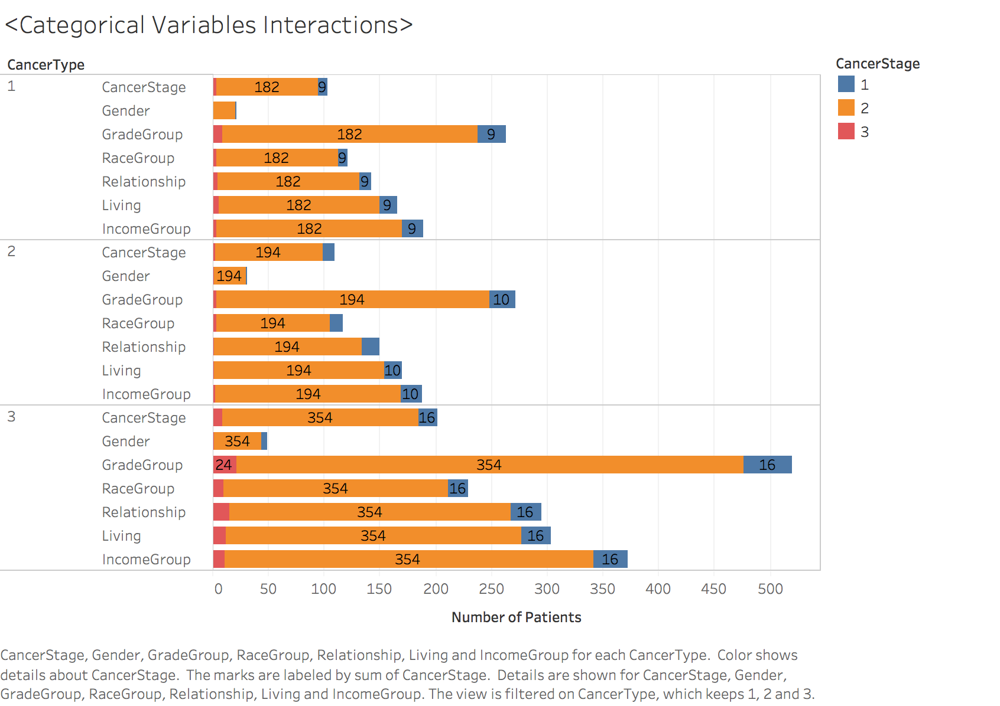
4.

Slide 10
Next Steps
Discuss with URMC Team about the progress we made on Thursday. Address the need to have the 42 remaining rows manually labelled by clinicians.
Continue exploratory analysis and discuss the issues about missing data with URMC team.
Try out different ML models and see how they perform.

Slide 11
Challenges
The labeled treatment dataset was not clean, which caused a lot of trouble during rule generation. We self acquired some knowledge about medicine and solved the issues.
Some remaining data needs clinical knowledge to label.
Some of the data are missing so we need to think of a way to deal with those.

